Slide 1

Angular…

Slide 2
History
In 2010 when the angular first get release, at that time angular was known by the name angular.js. It uses javascript, and there wasn’t any CLI for it.
If you learn Angular.js then probably you can’t code in Angular. But when you will start learning Angular, you might understand lots of things because some fundamentals are same.

Slide 3
So, Angular.js and Angular are different
.

Slide 4
Versions of Angular
2
4
5
6
7
8
9
10

Slide 5
Why Angular
Detailed documentation.
Support by Google.
Great ecosystem of third-party components.
Component-based architecture.

Slide 6
Why Angular
Component-based architecture.
In the second version, Angular shifted from an MVC to a component-based architecture. According to this architecture, an app is divided into independent logical and functional components. These components can easily be replaced and decoupled as well as reused in other parts of an app. In addition, component independence makes it easy to test a web app and ensure that every component works seamlessly.

Slide 7
Angular uses typescript
You write code in TypeScript and when you build you project, it gets transpile into JavaScript. It means you are still going to upload javascript to the web server.
TypeScript = JavaScript + Data Types

Slide 8
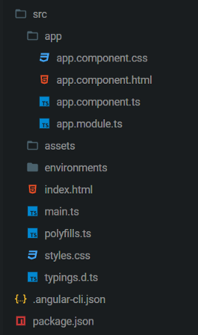
Angular CLI
Angular CLI came up with Angular v2.0, At that time Angular CLI was not stable but Now Angular CLI is the one of the best CLI in the world.

Slide 9
The three important files in Angular
component.html
component.css
component.ts

Slide 10
Uses of Angular CLI
Creating a new project
Creating new components
Creating new services
Adding Material Design (Schematics)
Adding Material Component i.e. Table, Form(Schematics)
Adding PWA (Schematics)
A lot more . . . . ..

Slide 11
Hello World of Angular
Once the angular is installed.
Open command prompt in a folder.
Run the command:
ng new my-hello-world-app //to create the app requirements
ng serve –o //to run the app on default browser

Slide 12
The Beginning…

Slide 13
Thank You!

